Slide 1
MODERN WIRELESS ENTRY/EXIT
SYSTEM BASED ON RFID AND GSM TECHNOLOGY

Slide 2
PREVIOUS WORK
Keying locks
Password protected systems
Traditional security systems with alarms
Security systems with fingerprint lock.
Notes:
Security systems may not work during power outages.

Slide 3
NOVELTY
It is linked with cellular communication
Even when the alarm is set off, the system can communicate with the monitoring center.
It helps to manage electricity.

Slide 4
OBJECTIVE
The main goal of this project is to design and implement a smart wireless entry/exit system which can be organized in bank, secured offices and home.
The project uses the GSM technology, RFID and Embedded Systems. It mainly consists two parts:
Home Security System
Domotics

Slide 5
INTRODUCTION
Implementing safety of the money in the bank locker, house, and office (treasury) by using RFID and GSM technology which will be more secure than other systems.
The RFID based access-control system allows only authorized people to get access through.

Slide 6
PROPOSED MODEL
RFID Reader
Power supply
Microcontroller board
ATmega 8
GSM Module
Sensors

Slide 7
HARDWARE USED
AVR MICROCONTROLLER(Atmega8)
RFID (EM18) READER
GSM (SIM900) MODULE
16x2 ALPHANUMERIC LCD
PIR SENSOR
ALARM

Slide 8
ATmega 8
Features
8K BYTES Programmable Flash Memory
512 Bytes EEPROM
1K Bytes SRAM
23 Programmable I/O Lines
Analog to Digital Converter
Two 8-bit Timer/Counters with Separate Prescaler
One 16-bit Timer/Counter with Separate Prescaler
Three PWM Channels
Programmable Serial USART
Internal Calibrated RC Oscillator
External and Internal Interrupt Sources

Slide 9
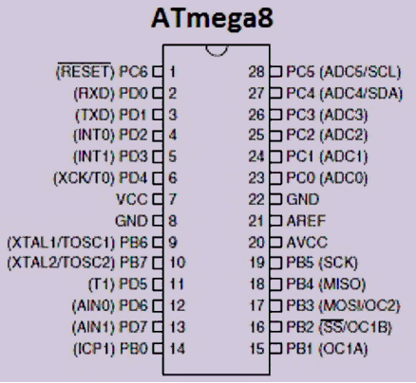
PIN DIAGRAM

Slide 10
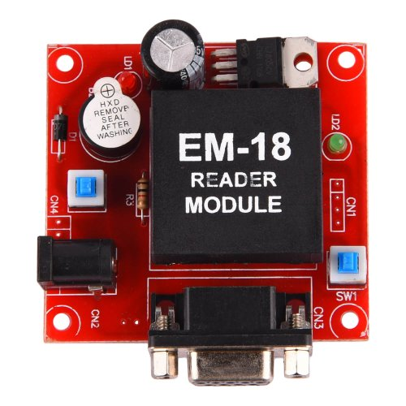
2. RFID (EM18) Reader
RFID - Radio Frequency Identification.
It consists of two parts:
A Reader
Transponders, also known
as Tags.
RFID systems evolved from barcode labels as a means to automatically identify and track products and people.

Slide 11
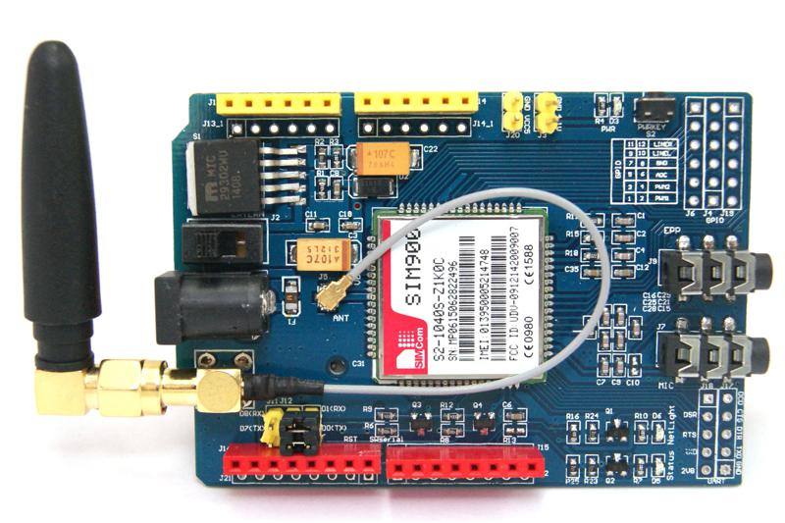
3. GSM (SIM900) MODULE
GSM - Global System for
Mobile communication
Most widely used digital
wireless telephony technology
Single supply voltage 12V
Circuit-switched network optimized for
full duplex voice telephony
It operates at either the 900 MHz or 1800 MHz frequency band.

Slide 12
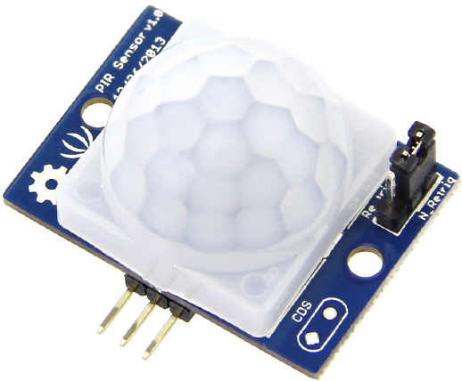
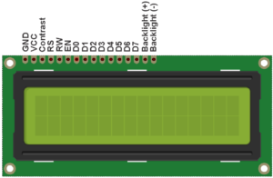
4. PIR Motion sensor:
Passive infrared motion detectors (PIR) detect emitted infrared energy
given off by humans and animals
in the form of heat.
5. LCD:
LCD stands for liquid
crystal display.
The LCD is denoted by
16x2 it means it has
16 columns and 2 rows.

Slide 13
Flow Chart of Working Principle
Start
Initialization of
LCD,RFID reader,GSM,Sensors
Check up for RFID tag
RFID tag detected
NO
NO
NO
YES
A
B
C
D

Slide 14
A
B
C
D
Contd..
Tag matched
Sensor ON
NO
Sense
YES
NO
Sensor ON
YES
Sense
SMS sent by GSM
NO
YES
Alarm
Electric Appliances ON
STOP

Slide 15
FUTURE OUTLOOK
Two step verification through OTP
Data Base for Screening process
Motion sensors that know you
Addition of video monitoring

Slide 16
ADVANTAGES
RFID is more secure than lock-key system
Cost efficient and easily available.
Optimum use of Power(Electricity).
Convenience

Slide 17
REFERENCES
Muhammad Ali Mazidi, “Book on AVR microcontroller and Embedded Systems using C”
Gyanendra K Verma, Pawan Tripathi, “A Digital Security System with Door Lock System Using RFID Technology”, International Journal of Computer Applications (IJCA) , Volume 5– No.11, August 2010
Malik Sikandar Hayat Khiyal, Aihab Khan, and Erum Shehzadi. “ SMS Based Wireless Home Appliance Control System (HACS) for Automating Appliances and Security”, Issues in Informing Science and Information Technology. Vol. 9. 2009.
https://en.wikipedia.org
https://www.engineersgarage.com/embedded/avr-microcontroller-projects/rfid-interfacing-circuit

